Slide 1
Minor Project Presentation : MCE461P
GENE PATHWAY MAPPING AND CLUSTERING OF PROLONGED COVID-19 (SARS-COV-2) VIRUS
Name (USN)
Dr.
Associate Professor
Dept. of Computer Science and Engineering
RVCE

Slide 2
PRESENTATION CONTENTS
Introduction
Problem Statement
Objectives
Literature Survey
Methodology
Design and Workflow
Algorithmic Development
Implementation
Conclusion
References

Slide 3
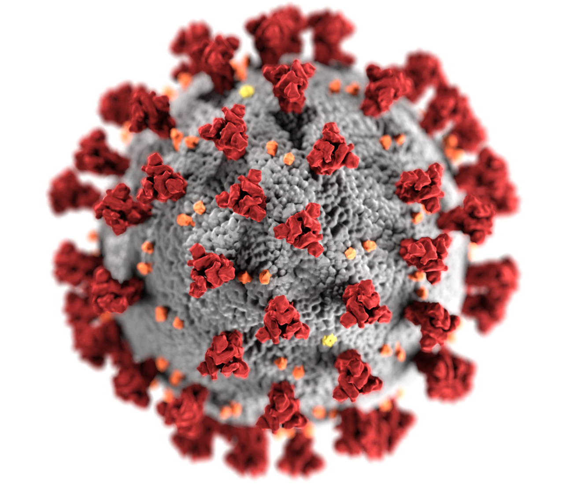
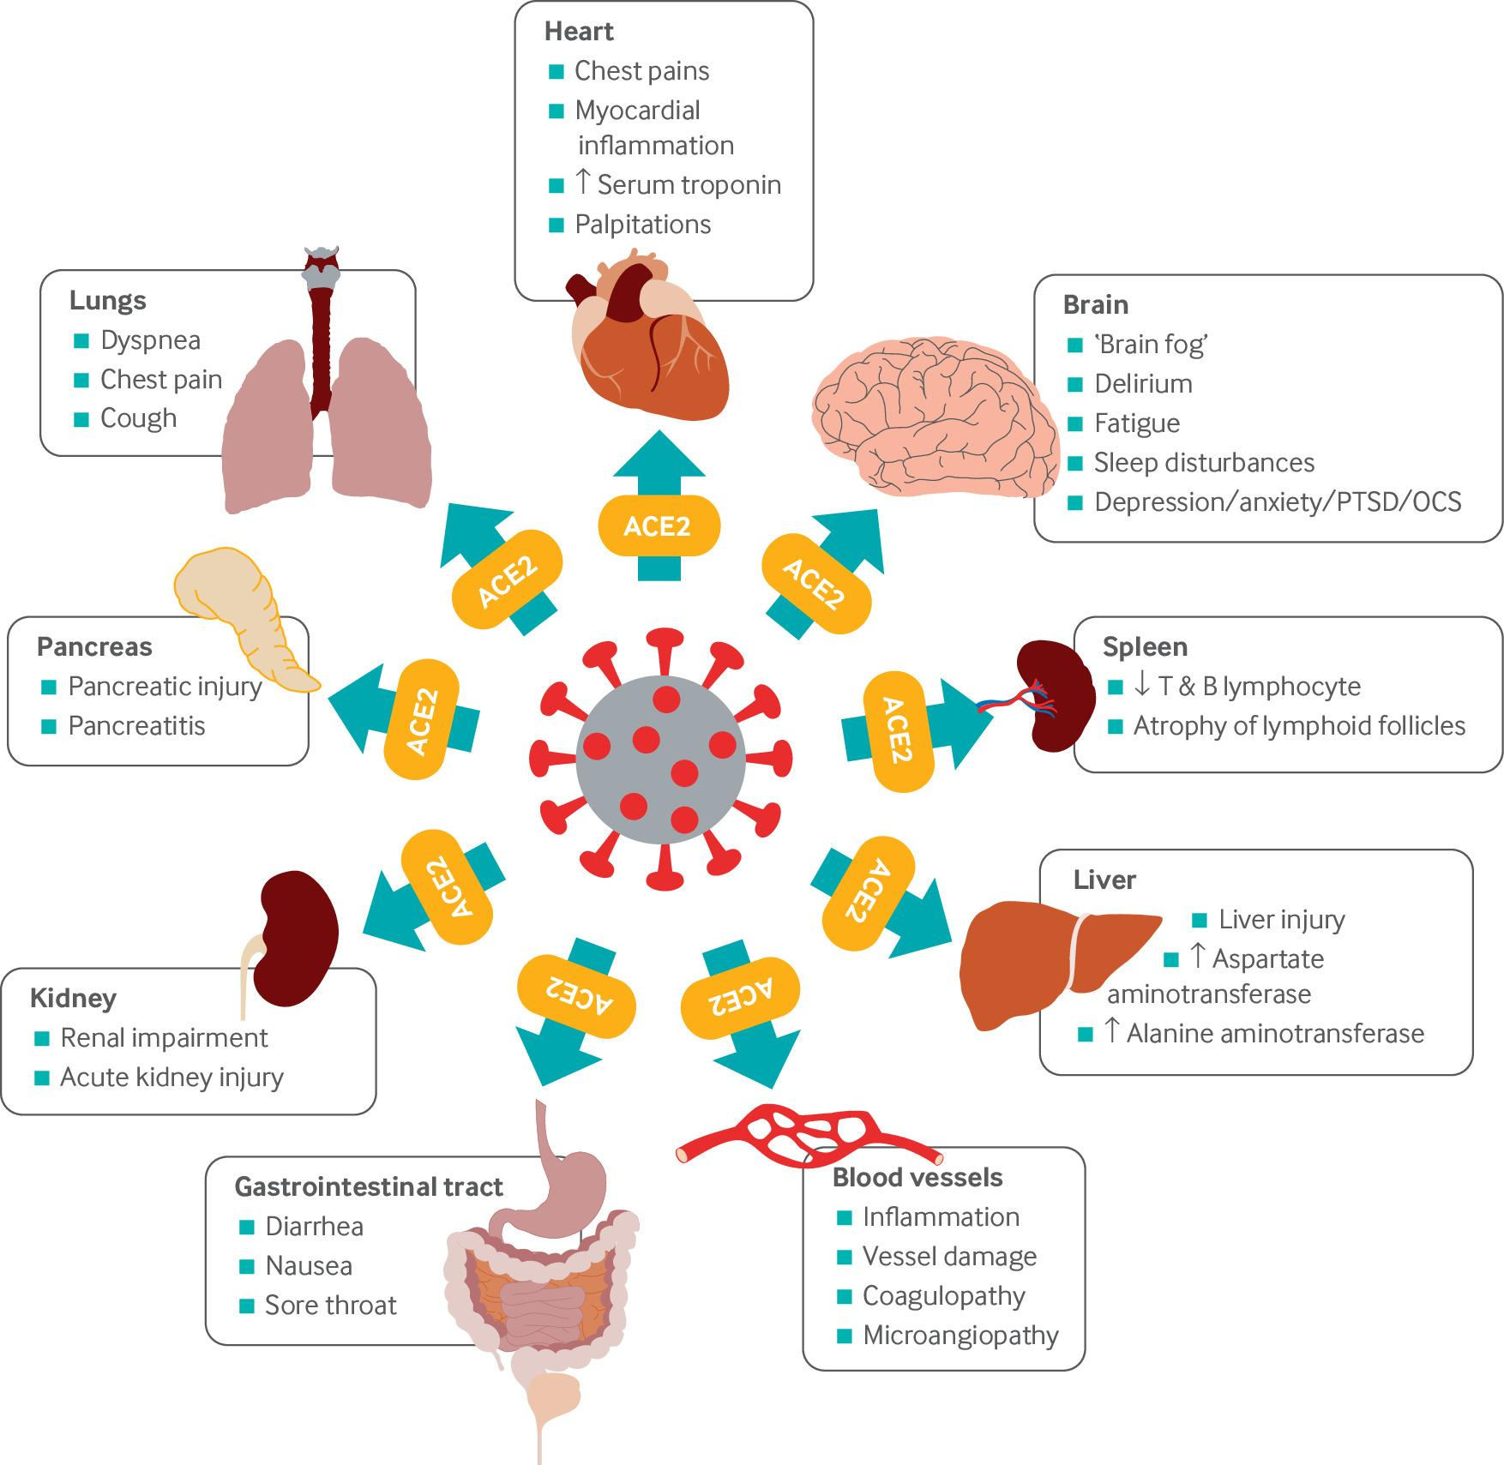
INTRODUCTION
Coronavirus Disease, COVID-19, is an infectious diseases caused by SARS-COV-2 virus
Long Covid (Prolonged Covid, Post-Covid Conditions) is an illness characterized by range of ongoing symptoms that can last weeks, months, or even years after a SARS-COV-2 infection
SARS-COV-2 Virus
Long Covid can affect many organs

Slide 4
PROBLEM STATEMENT
The SARS-CoV-2 virus has undergone multiple mutations since its emergence, leading to the evolution of variants with different infectivity, transmissibility, and immune escape mechanisms.
Understanding the genomic mutations in the virus and their impact on human infection is crucial for
tracking the spread of new variants,
evaluating vaccine effectiveness,
developing targeted therapeutic strategies.
This project’s problem statement is to analyze the genome sequences of humans affected by the SARS-CoV-2 virus to identify genetic mutations and their impact on biological pathways

Slide 5
OBJECTIVES
The objectives of the project is to,
Analyze the genome sequences of humans affected by the SARS-CoV-2 virus to identify genetic mutations and their impact on biological pathways
Provide actionable insights into potential health impacts and management strategies
Integrate advanced computational techniques like SNP analysis, population genetics, machine learning, web interface for comprehensive analysis and to map the analyzed genetic variants to biological pathways and organ systems, predicting their impact.
By integrating multiple bioinformatics tools and automating the analysis through a structured pipeline, the project efficiently detects genetic variants, generates consensus sequences, and maps affected genes to their respective pathways.

Slide 6
LITERATURE SURVEY
TITLE | Year Author Publication | LITERATURE SURVEY
Long COVID, a comprehensive systematic scoping review | 2021 | Reviewed the literature about “Long Covid” 120 publications: 49% on Signs, Symptoms 23% on Management 11% on Pathophysiology Controversies in definition has impaired proper recognition Symptoms: Fatigue, Breathlessness, lot of long term consequences
 | Hossein Akbarialiabad, Mohammad Hossein Taghrir, Ashkan Abdollahi, Nasrollah Ghahramani, Manasi Kumar, Shahram Paydar, Babak Razani, John Mwangi, Ali A. Asadi-Pooya, Leila Malekmakan, Bahar Bastani
 | Springer Nature

Slide 7
LITERATURE SURVEY
TITLE | Year Author Publication | LITERATURE SURVEY
Long COVID: major findings, mechanisms and recommendations | 2023 | Long Covid occurs in 10% of SARS-Cov-2 infections 200 symptoms have been identified with impacts on multiple organ system. At least 65 million people have had Long Covid GAP: Current diagnostic and treatment options are insufficient, clinical trials must be prioritized Vaccination provides protection, with 15% to 41% reduces risk MISCUE: COVID 19 doesn’t only have respiratory sequelae, but also neurological, cardiovascular, ME/CFS type presentations
 | Hannah E. Davis, Lisa McCorkell, Julia Moore Vogel, Eric J. Topol
 | Nature Reviews: Microbiology

Slide 8
LITERATURE SURVEY
TITLE | Year Author Publication | LITERATURE SURVEY
Genetics and genomics of SARS-CoV-2: A review of the literature with the special focus on genetic diversity and SARS-CoV-2 genome detection | 2021 | Understanding the genetics of SARS-Cov-2 helps developing strategies, diagnosis, treatment Genome sequence (MN908947.3) available on GenBank Sequence alignment and Phylogenetic tree analysis showed it’s a new member of β-CoV Enveloped, Non-segmented, positive-sense single stranded RNA virus, that performs translation of replicase polyproteins Encodes 4 structural proteins: Spike (S), Envelope (E), Membrane (M), Nucleocapsid (N) 12 ORF (open reading frames) encodes 27 proteins Mutation Rate: 8 x 10^-4 nucleotides per year 17 high frequency mutations in genes – including ORF1ab, ORF3a, ORF6, S, M, E, N 241C > T, 3037C > T, 23403A > G – most common
 | Azadeh Rahimi, Azin Mirzazadeh, Soheil Tavakolpour
 | Elsevier

Slide 9
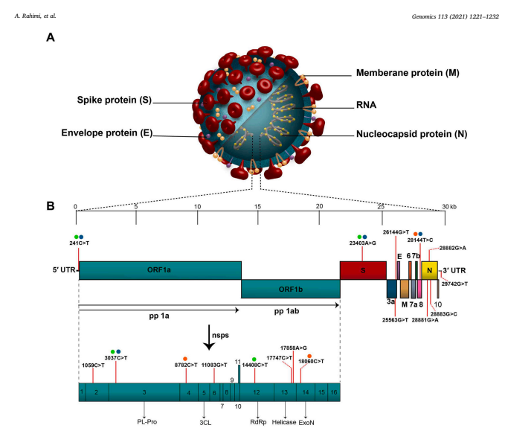
LITERATURE SURVEY

Slide 10
LITERATURE SURVEY
TITLE | Year Author Publication | LITERATURE SURVEY
Cluster analysis of long COVID symptoms for deciphering a syndrome and its long‑term consequence | 2024 | Assessed 2371 participants to cluster the different long COVID symptoms Cluster A: Rheumatological, Cluster B: Neuro-Physiological with Cardiorespiratory, Cluster C: General infection, dermatological, otology Limitations: Relied on self- reported assessment of symptoms by participants May not be representative of general population Future Scope: Interesting to link syndromes with understanding of their pathophysiology
 | J. Niewolik, M. Mikuteit, S. Klawitter, D. Schröder, A. Stölting, K. Vahldiek, S. Heinemann, F. Müller, GMN. Behrens, F. Klawonn, A. Dopfer-Jablonka, S. Stefens
 | Springer

Slide 11
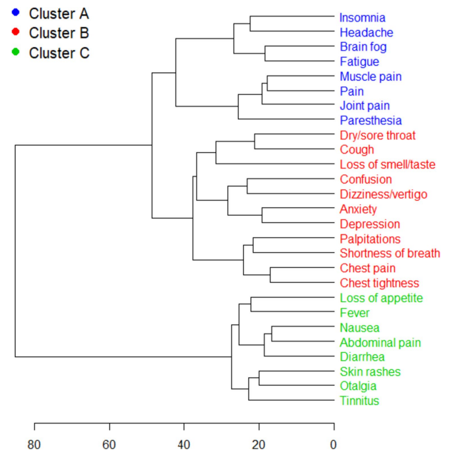
LITERATURE SURVEY

Slide 12
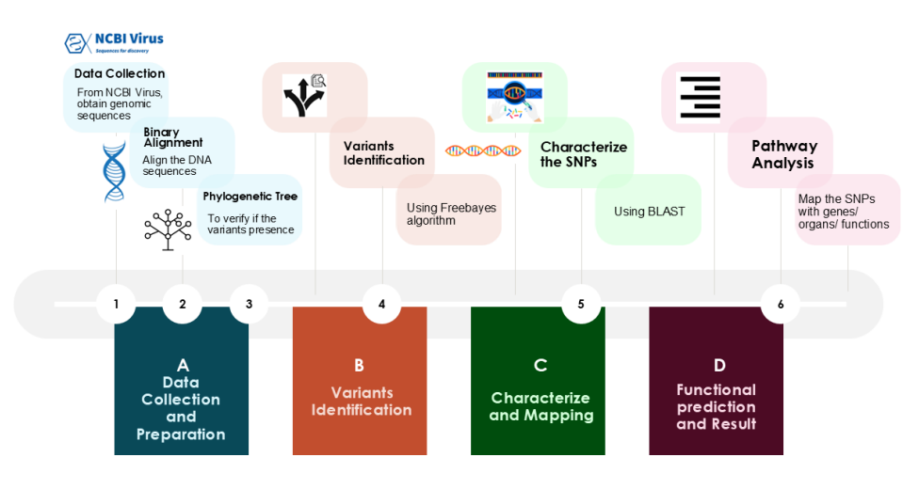
METHODOLOGY

Slide 13
Design
OBTAIN GENOMIC DATA: (Reference and Sample Genomes) from the database at National Center for Biotechnology Information (NCBI)
SEQUENCE ALIGNMENT:
Align the sample genomes with reference genome using Burrows-Wheeler Transform for maximal exact matches
Convert text-based, human-readable sequence alignments into binary format for efficient processing and storage

Slide 14
Design
VARIANT IDENTIFICATION (Crucial Step)
Detect genetic variations (SNPs, InDels,…) in sample genomes wrt reference genome.
FreeBayes algorithm, based on Bayesian approach, is used to detect these VARIANTS. The variant information of position, chromosome, and other metrics is identified

Slide 15
Design
CONSENSUS SEQUENCE Generation:
New sequence is generated by incorporating all the different variants observed that represents the genetic profile of the sample considered
By generating the consensus sequence, unique SNPs can be focused for identifying mutations and study evolutionary changes
SNP to GENE MAPPING:
By using the identified SNPs in consensus sequence, through mapping tools like BLAST, corresponding gene and potential functional impacts can be provided

Slide 16
Algorithm Development/Implementation
FreeBayes Algorithm freebayes is a Bayesian genetic variant detector designed to find polymorphisms, specifically - SNPs (single-nucleotide polymorphisms), - indels (insertions and deletions), - MNPs (multi-nucleotide polymorphisms), and - complex events (composite insertion and substitution events)
It is designed to analyze diverse sequencing datasets, including pooled and population-scale samples
Haplotype-based Approach: It analyzes combinations of alleles (haplotypes) to call variants, particularly useful for indels and complex variants.

Slide 17
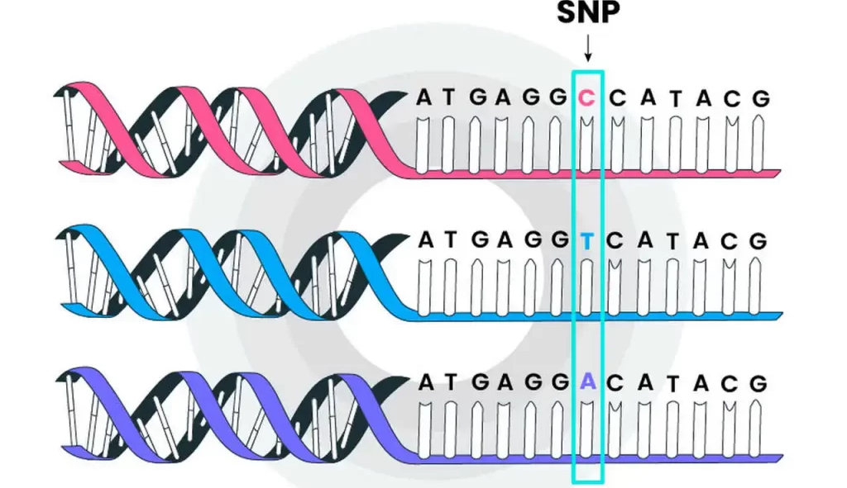
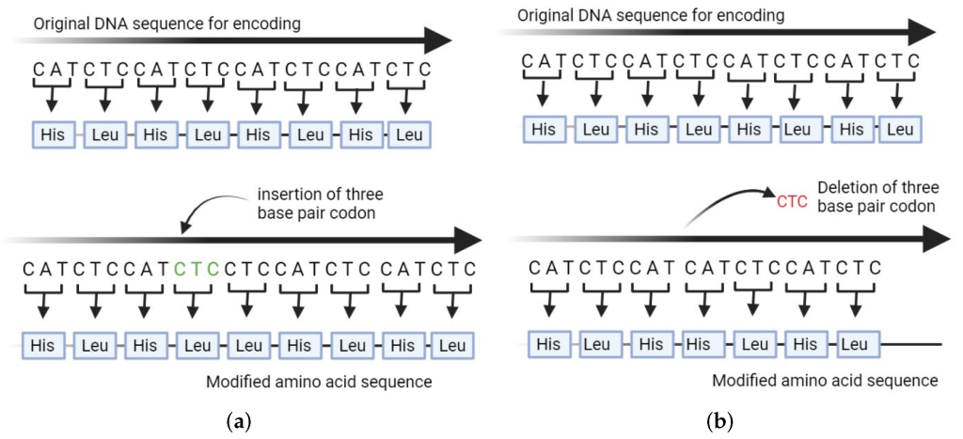
Algorithm Development/Implementation

Slide 18
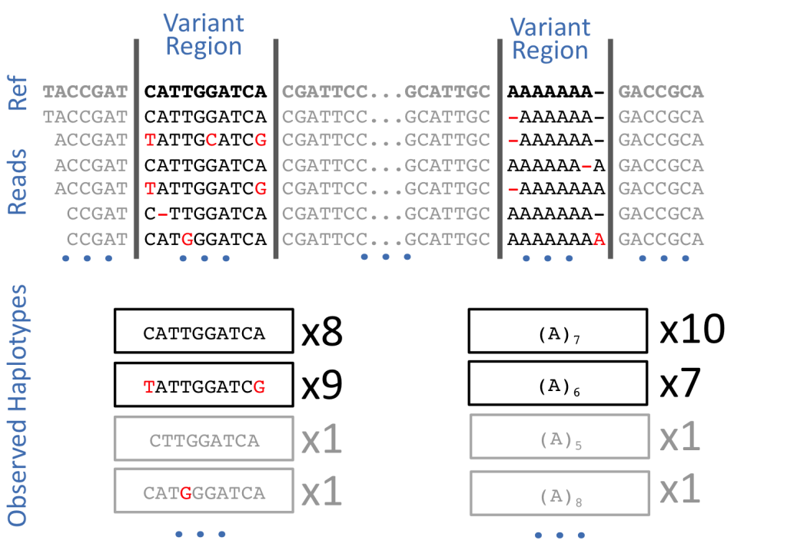
Algorithm Development/Implementation

Slide 19
Algorithm Development/Implementation
Burrows–Wheeler transform Algorithm
The Burrows-Wheeler Transform (BWT) is a reversible transformation of a string that helps to reorganize the characters in a way that makes the string more amenable to compression.
The BWT algorithm is used to rearrange the characters of the input string into a matrix of all its cyclic permutations. It then extracts the last column of this matrix, which often contains characters that are more repetitive and therefore compressible.
The result of the BWT transformation is a string that has many consecutive repeating characters, which is easier to compress using algorithms like Run-Length Encoding (RLE) or Huffman coding. This helps in reducing the space required to store data and speeds up tasks like genome sequence matching.

Slide 20
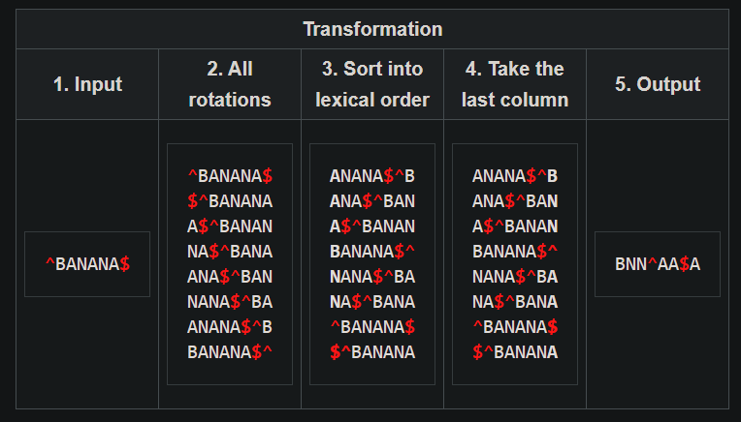
Algorithm Development/Implementation

Slide 21
Algorithm Development/Implementation
B, NN, AAA
X, Y, Z
B, A, N, A, N, A
X, Y, Z, U, V, W
Efficient for Storage
Easier to Reverse

Slide 22
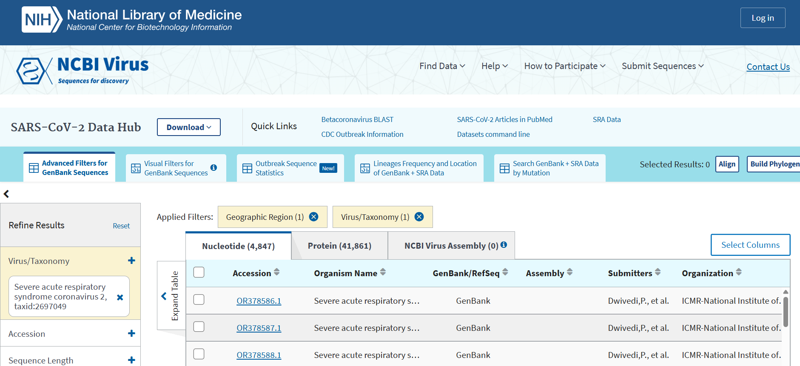
Demonstration of the work
Data ingestion from NCBI Genome Library for the SARS-COV-2 reference genome and genome sequences of human population infected

Slide 23
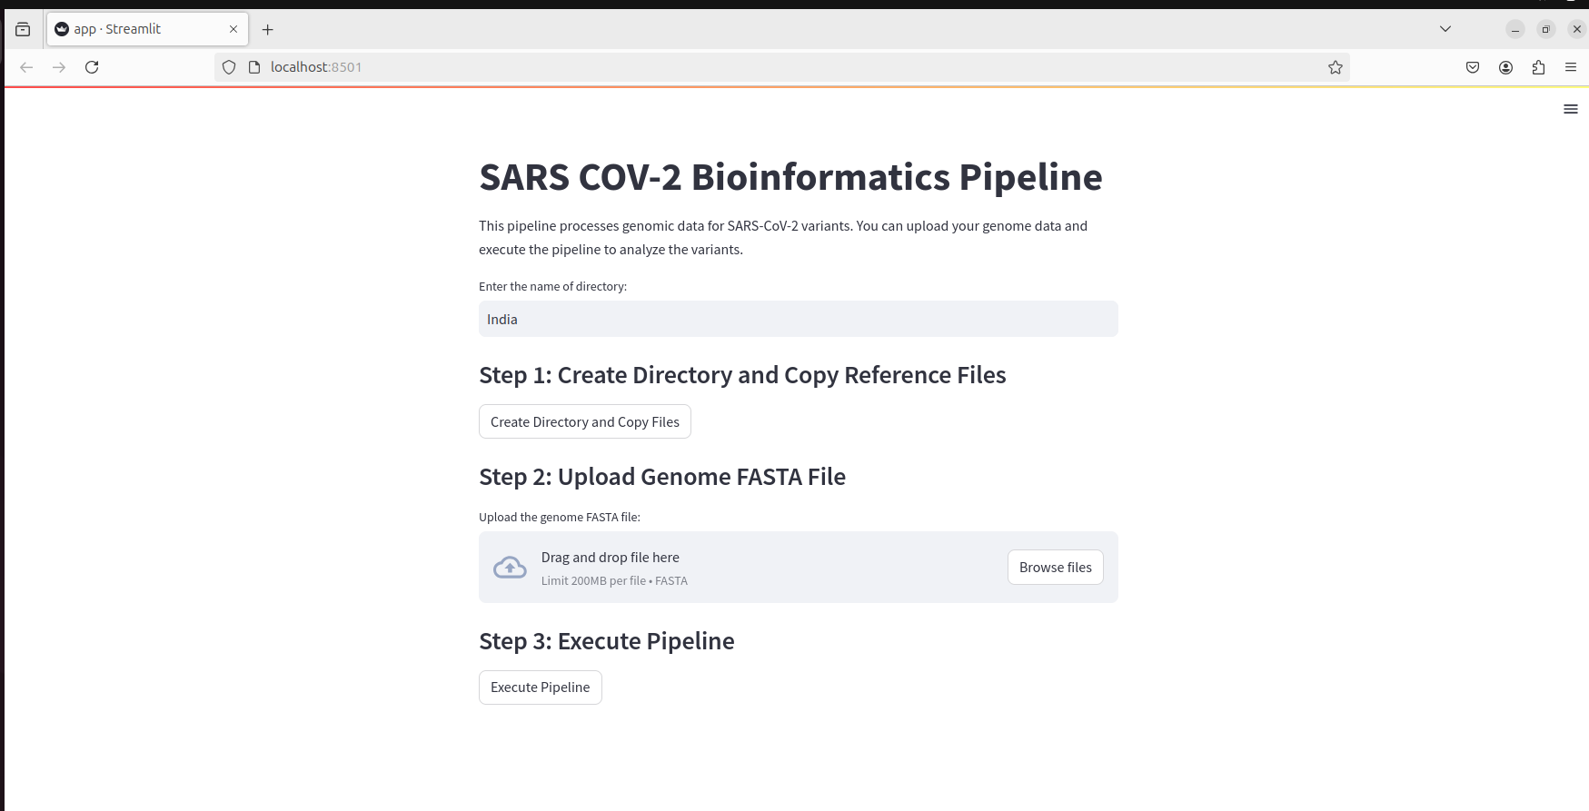
Demonstration of the work
Web interface of the Pathway Analysis Pipeline

Slide 24
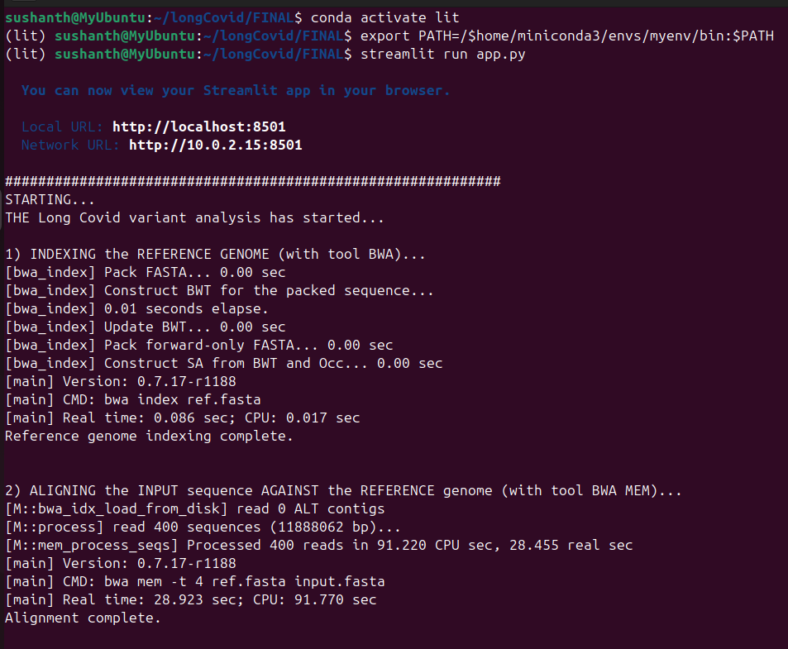
Demonstration of the work
Execution of the Processes in the Pipeline

Slide 25
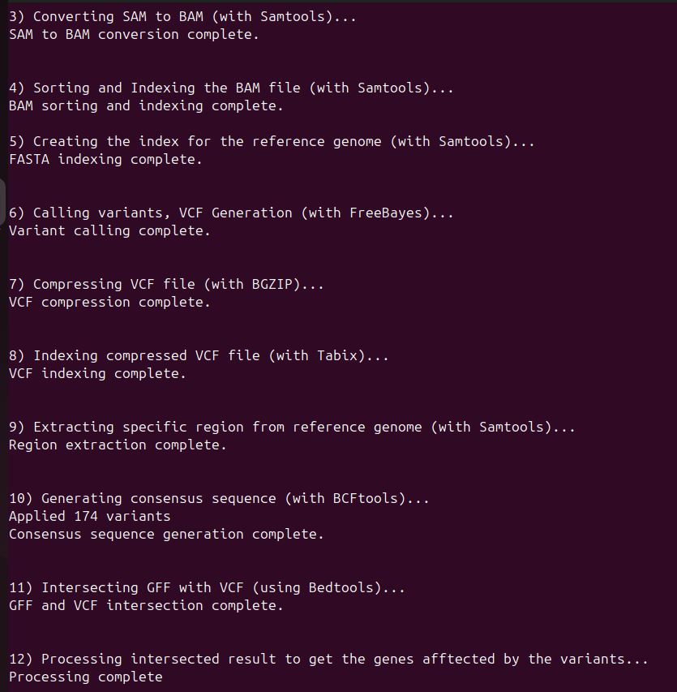
Demonstration of the work
Execution of the Processes in the Pipeline

Slide 26
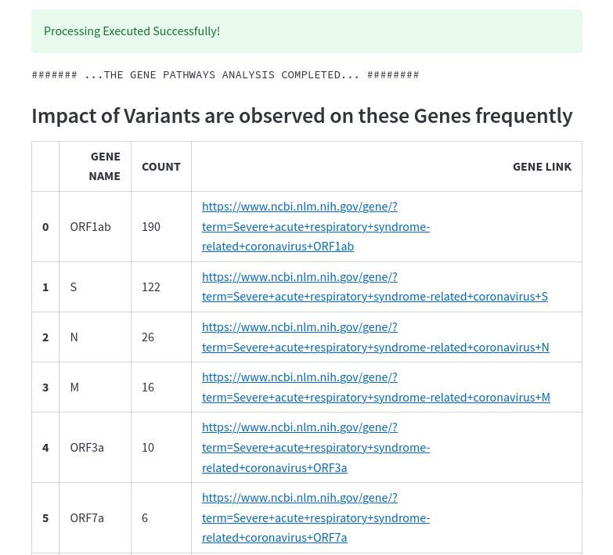
Results and its Analysis
The results after computationally intense analysis of genomes

Slide 27
Conclusion and Future Enhancements
The study successfully identified frequent mutations in genes, which play a crucial role in viral replication, immune evasion, and prolonged infection symptoms. Through sequence alignment, variant detection, annotation, and pathway mapping, the project provided insights into how genetic variations influence disease progression and long- term effects in infected individuals.
The future enhancements can include, combining multi-omics data (genomics, proteomics, and transcriptomics) could provide a more comprehensive understanding of how prolonged COVID-19 develops at the molecular level.
These advancements will enhance mutation tracking, therapeutic target identification, and public health interventions, contributing to better diagnostics and treatment strategies for long-term SARS-CoV-2 infections.

Slide 28
References
Wolf, S., Zechmeister-Koss, I. & Erdös, J. Possible long COVID healthcare pathways: a scoping review. BMC Health Serv Res 22, 1076 (2022). https://doi.org/10.1186/s12913-022-08384-6
Davis, H.E., McCorkell, L., Vogel, J.M. et al. Long COVID: major findings, mechanisms and recommendations. Nat Rev Microbiol 21, 133–146 (2023). https://doi.org/10.1038/s41579-022-00846-2
Rahimi A, Mirzazadeh A, Tavakolpour S. Genetics and genomics of SARS-CoV-2: A review of the literature with the special focus on genetic diversity and SARS-CoV-2 genome detection. Genomics. 2021 Jan;113(1 Pt 2):1221-1232. doi: 10.1016/j.ygeno.2020.09.059. Epub 2020 Sep 30. PMID: 33007398; PMCID: PMC7525243.
Niewolik, J., Mikuteit, M., Klawitter, S. et al. Cluster analysis of long COVID symptoms for deciphering a syndrome and its long-term consequence. Immunol Res 72, 605–613 (2024). https://doi.org/10.1007/s12026-024-09465-w
Severe acute respiratory syndrome coronavirus 2 isolate Wuhan-Hu-1, complete genome. GenBank: MN908947.3. https://www.ncbi.nlm.nih.gov/nuccore/MN908947

Slide 29
References
Smith T, Rohaim MA, Munir M. Mapping molecular gene signatures mediated by SARS-COV-2 and large-scale and genome-wide transcriptomics comparative analysis among respiratory viruses of medical importance. Mol Cell Probes. 2022 Aug;64:101820. doi: 10.1016/j.mcp.2022.101820. Epub 2022 Apr 30. PMID: 35504488; PMCID: PMC9054707.
Akbarialiabad H, Taghrir MH, Abdollahi A, Ghahramani N, Kumar M, Paydar S, Razani B, Mwangi J, Asadi-Pooya AA, Malekmakan L, Bastani B. Long COVID, a comprehensive systematic scoping review. Infection. 2021 Dec;49(6):1163-1186. doi: 10.1007/s15010-021-01666-x. Epub 2021 Jul 28. PMID: 34319569; PMCID: PMC8317481.
Nunes DR, Braconi CT, Ludwig-Begall LF, Arns CW, Durães-Carvalho R. Deep phylogenetic-based clustering analysis uncovers new and shared mutations in SARS-CoV-2 variants as a result of directional and convergent evolution. PLoS One. 2022 May 24;17(5):e0268389. doi: 10.1371/journal.pone.0268389. PMID: 35609034; PMCID: PMC9129020.

